Slide 1
SANDS Real Estate
Ashwini H
Deepak V
Nigil M R
Shahbaz Q
Sai B

Slide 2
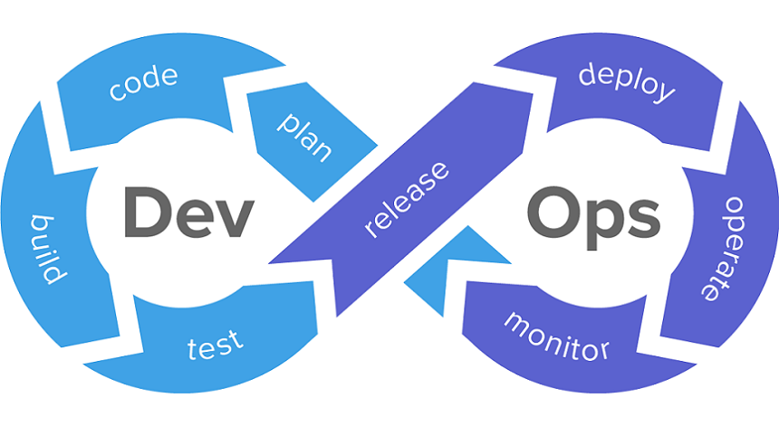
Table Of Content
Problem Statement
Requirements
Project
Git
Maven
Docker
Nexus
Jenkins

Slide 3
Problem Statement
Create application with bare minimum CRUD operations
Apply DevOPs concepts
Build replica of MySql database in mongodb and store the file in project repository

Slide 4





Spring Boot Requirements

Slide 5
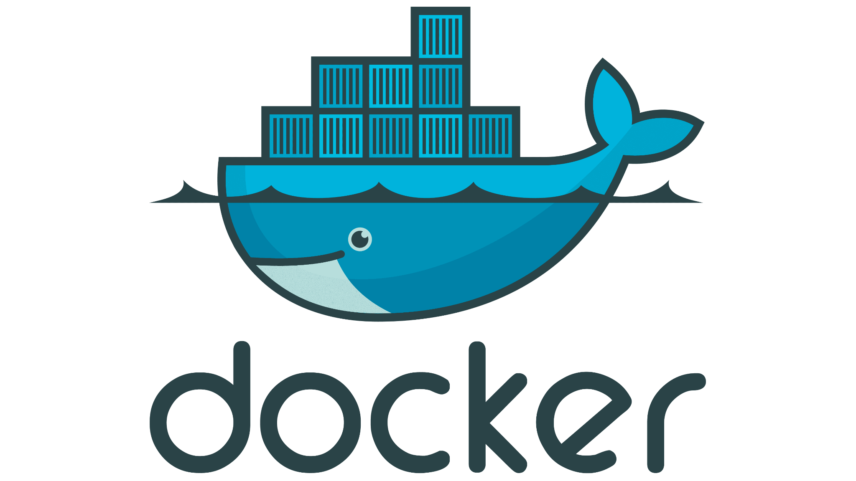


Devops Requirements

Slide 6

SANDS REAL ESTATE
SANDS real estate is a spring boot application project.
It’s a real estate project where the users doesn’t require third party
It allows the buyer to see all the details of the property before approaching to buy it
The owners can easily add the property in details to attract the buyers
There are two users who can use this application Admin and User
Admin can perform crud operations with all the properties
User can view the details of properties available and also add the property for sale

Slide 7
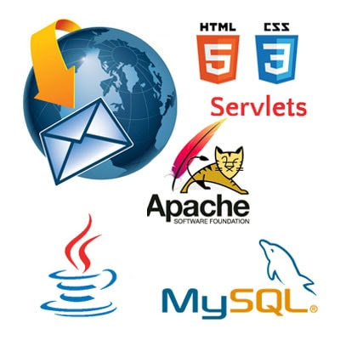
Technologies Used
Backend Spring Boot
Database MySql
Frontend HTML CSS Bootstrap Java Script Thymeleaf

Slide 8
Flow of Application
Landing Page
Admin
View Property
Add Property

Slide 9
Admin
Manage all users
Add Property
Edit Property
Delete Property
View Property

Slide 10
Add Property
Manage User Property
Add Property
Edit Property
Delete Property
View Property

Slide 11
View Property
Based on Category
Land
Villa
Apartment
Rent

Slide 12

Git and GitHub
Git is a version control system
Github is integrated with intellij to manage application
Github is integrated with jenkins and nexus for CI/CD

Slide 13

Maven
Maven is a project management tool which is used for building, testing, packaging source code into artifact and managing project dependencies
We use maven to
Build artifact
Manage project dependencies

Slide 14
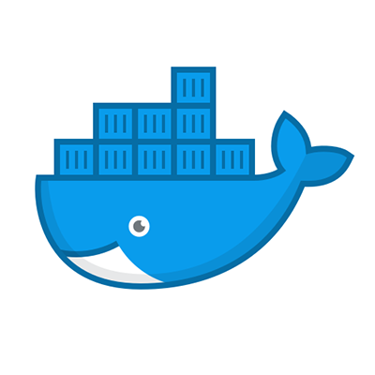
Docker
Docker is an open source container management tool used
to create, deploy and manage the virtualized application
containers on a common operating system
We used docker to package our application as an image
and run as a container

Slide 15
Steps For Dockerizing Application:
Create artifact of application using maven
Create image of the application using Dockerfile
Create common network
Create mysql container to act as a database to the application
Create container of the application and link with env file which contains database information

Slide 16

Nexus
Nexus is an artifact repository management tool used to store and retrieve build artifacts
We integrated nexus with jenkins to store the artifacts

Slide 17
Nexus Configuration Steps
Install Nexus(login)
Create Repository
Select Maven2(hosted)
Name Team-5-artifact-repository
Version Policy Mixed
Hosted Section Deployment Policy Allow redeploy
Create User
Id jenkins-user First Name jenkins
Email abc@gmail.com Last Name user
Status Active Roles nx-admin

Slide 18

Jenkins
Jenkins is an open source automation server. It helps to automate the parts of software development related to building, testing, and deploying, facilitating continuous integration and continuous delivery
We integrate jenkins with github to automate build of our application after each commit
We integrate jenkins with nexus repository to upload the artifact after each build
We used Jenkinsfile to perform above task

Slide 19
Jenkins Configuration Steps:
Install Jenkins(with suggested plugins)
Install Nexus artifact uploader and pipeline utility steps plugins (Manage Jenkins Manage Plugins Available)
Install Maven (Manage Jenkins Global Tool Configuration )
Add Nexus Credentials(Manage Jenkins Manage Credentials)
Create new pipeline job(Name realestate_application)
Select Github Project and provide url of Github repository
Build Triggers Poll SCM Schedule * * * * * (To trigger build after commit)
Add script for building the project present in github and uploading the artifact to nexus repository

Slide 20
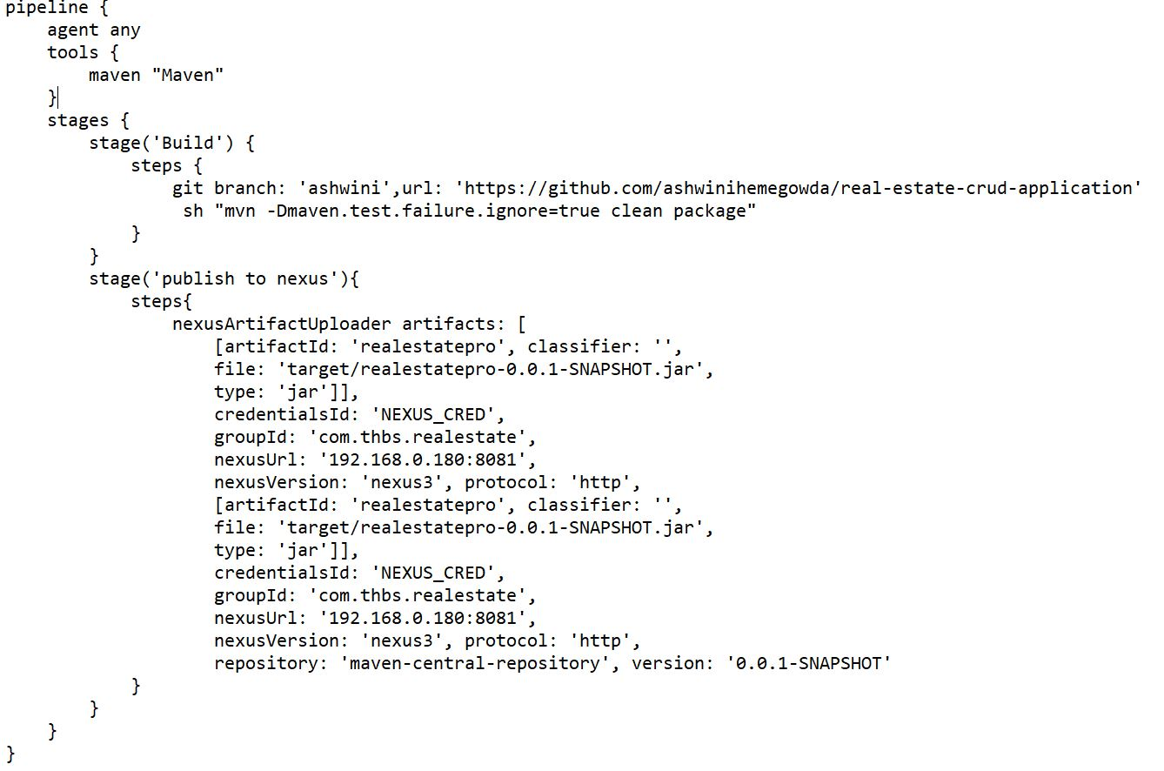

Slide 21
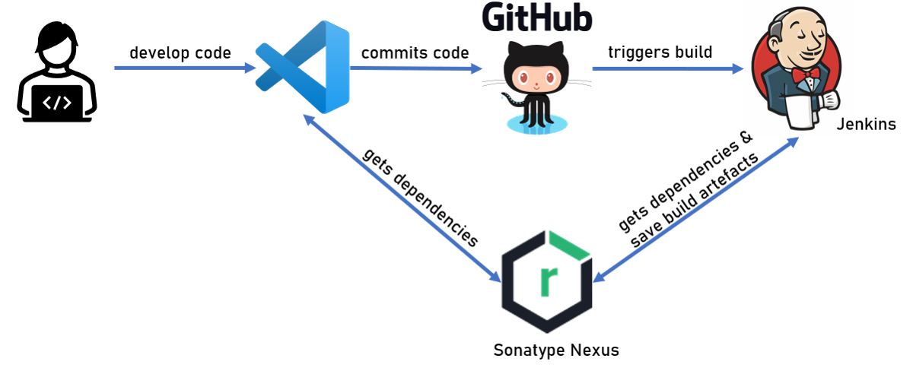

End-To-End Flow

Slide 22

Sprint
Features | Duration
Admin | 1 Week
Login | 4 Days
View Property | 4 Days
User Add Property | 1 Days
Front End Design | 3 Days
Docker | 4 Days
Jenkins and GitHub Jenkins and Nexus | 2 Days 1 Week
MongoDB | 1 Day

Slide 23


